Slide 1
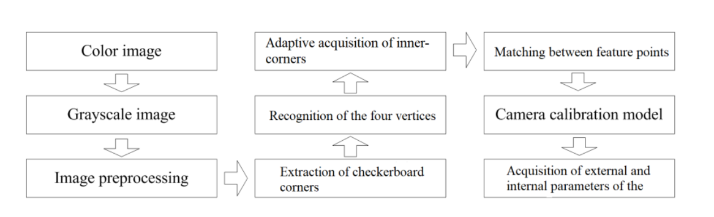
Mechanism of checkerboard-based automatic camera calibration

Slide 2
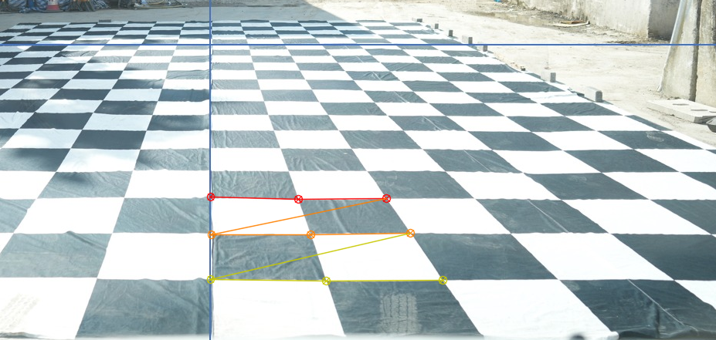
[fx 0 cx]
[0 fy cy]
[0 0 1]
[[365.58167652 0. 706.98942815]
[ 0. 59.67987449 396.01662478]
[ 0. 0. 1. ]]
Distortion coefficients [k1 k2 k3 p1 p2]:
[[-2.67425800e-03 -8.07274191e-05 -5.23208240e-04 -1.99025254e-04
1.85416649e-06]]
Rotation vectors:
(array([[-0.47152923],
[ 0.01069681],
[-0.00932886]]),)
Translation vectors:
(array([[-1.12416498e-03],
[ 1.07864127e+01],
[ 3.06794170e+00]]),)

Slide 3
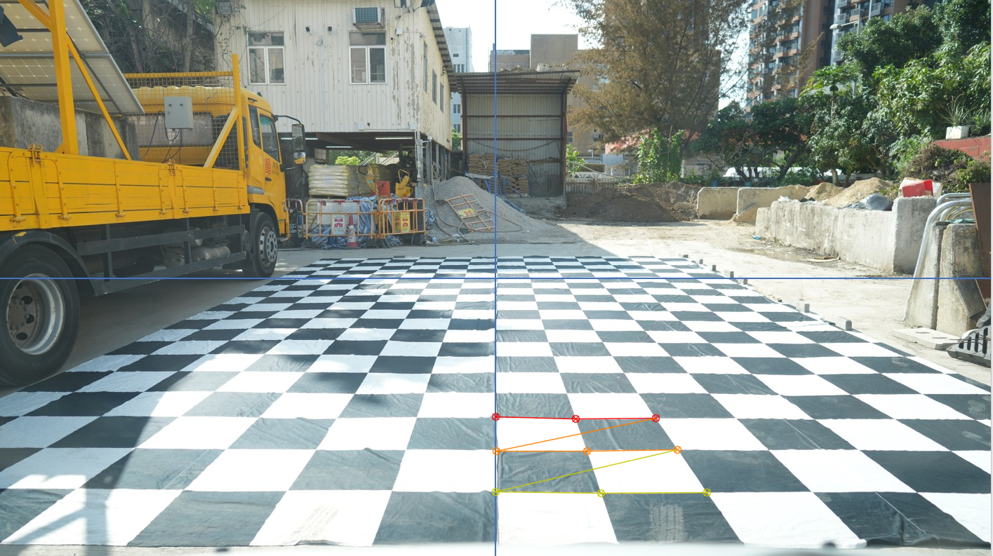

Slide 4
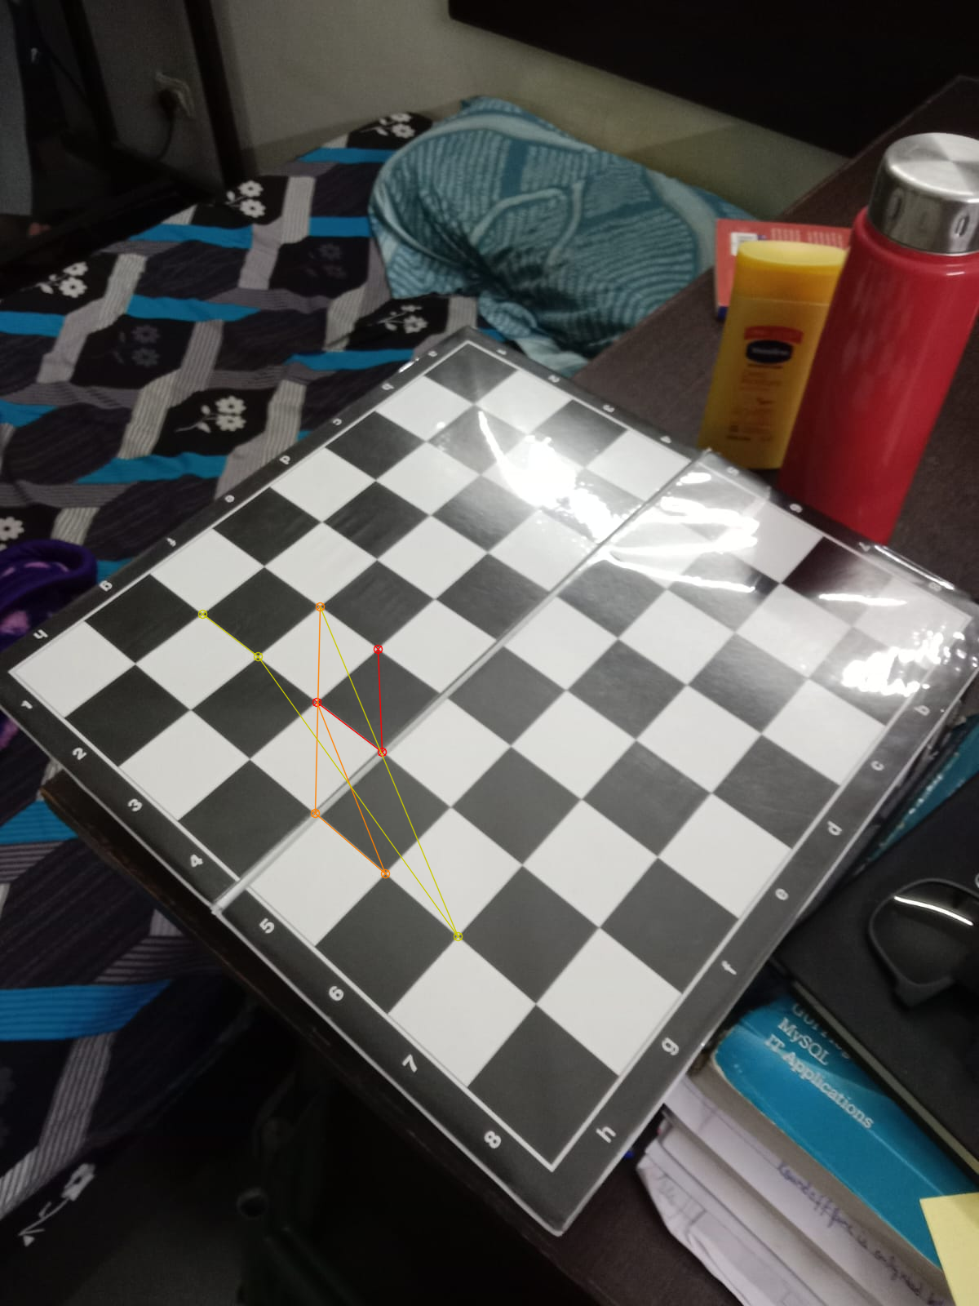

Slide 5
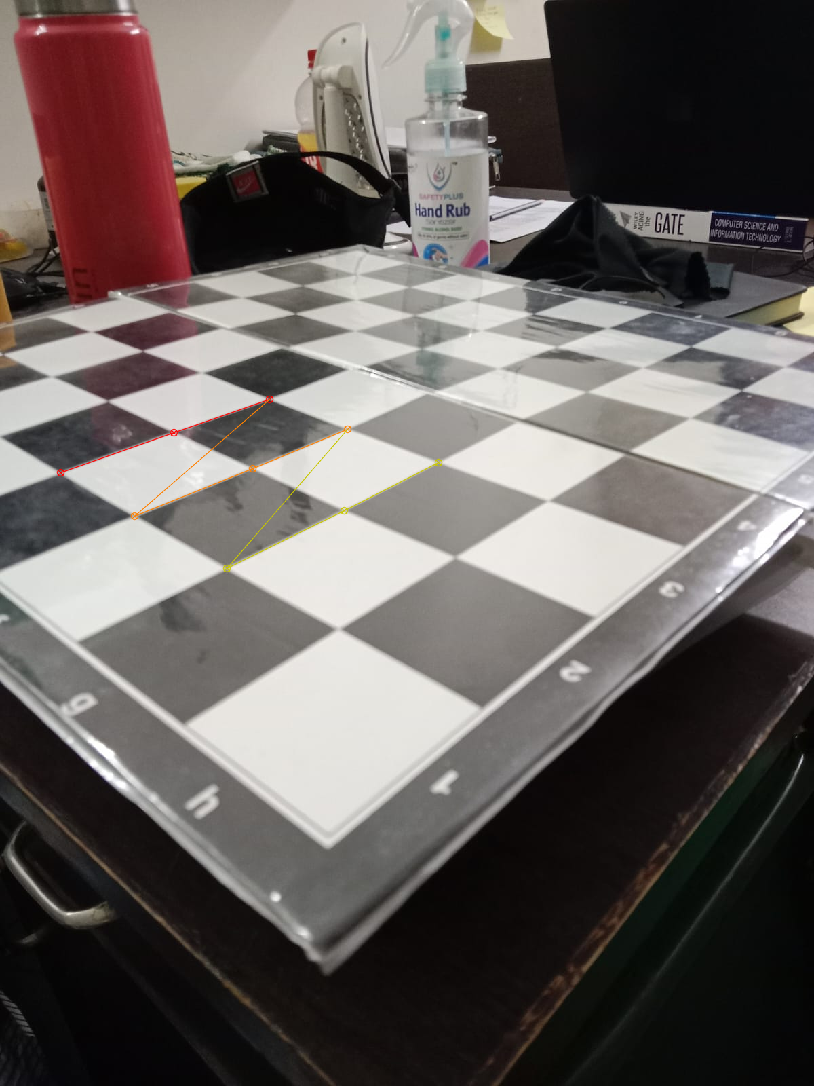

Slide 6
Mobile Properties
a. image_X = 4160
b. image_Y = 3120
sensor size = to determine sensor size is to look at the pixel size on the sensor and multiply by the resolution.
To determine the sensor size of a camera with given pixel size and resolution, you can use the following formula:
Sensor diagonal size = √((pixel width^2 + pixel height^2) x pixel size^2) where
pixel width: the horizontal resolution of the sensor in pixels (3120 pixels in this case)

Slide 7
Contd….
pixel height: the vertical resolution of the sensor in pixels (4160 pixels in this case)
pixel size: the size of each individual pixel on the sensor in microns (1.15 microns in this case)
Let's plug in the values and calculate the sensor diagonal size:
Sensor diagonal size = √((3120^2 + 4160^2) x 1.15^2)
= √((9,734,400 + 17,305,600) x 1.3225)
= √(27,040,000 x 1.3225)
= √35,809,320.0
Sensor diagonal size = 5,984.14 microns (rounded to two decimal places)
So, based on the given pixel size of 1.15 microns and resolution of 3120 x 4160, the estimated sensor diagonal size would be approximately 5,984.14 microns or 5.98 mm (rounded to two decimal places).
focal length = 3.66 mm f= 3.66mm

Slide 8
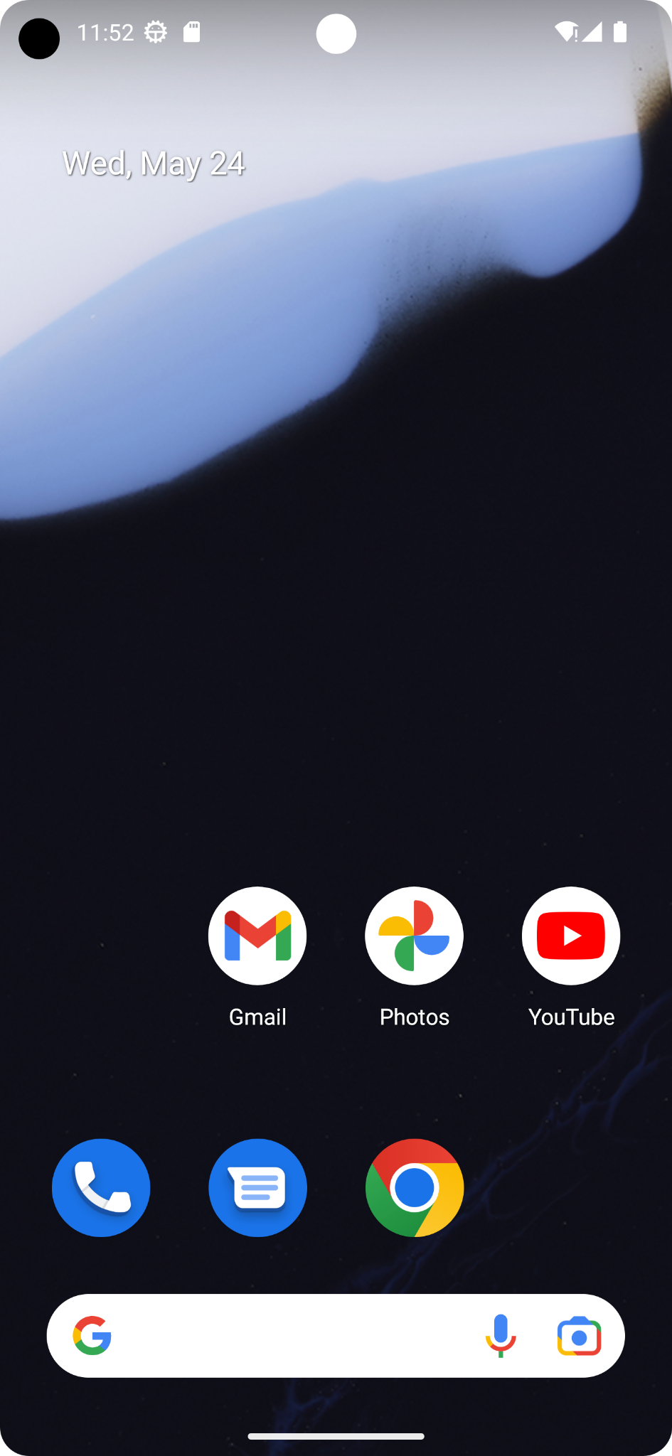

Calibration in
Android app

Slide 9



Tools used in Project

Slide 10
Flow of Android Project
Kotlin
(Frontend)
Chaquopy
(API)
Python
(Backend)

Slide 11
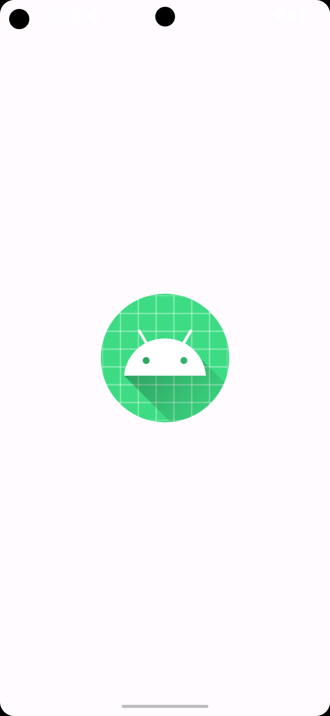
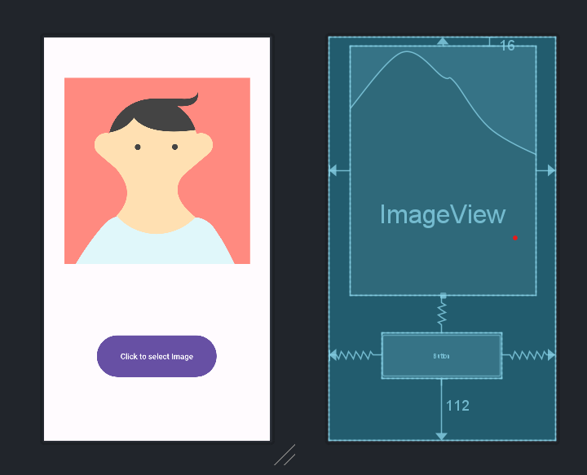
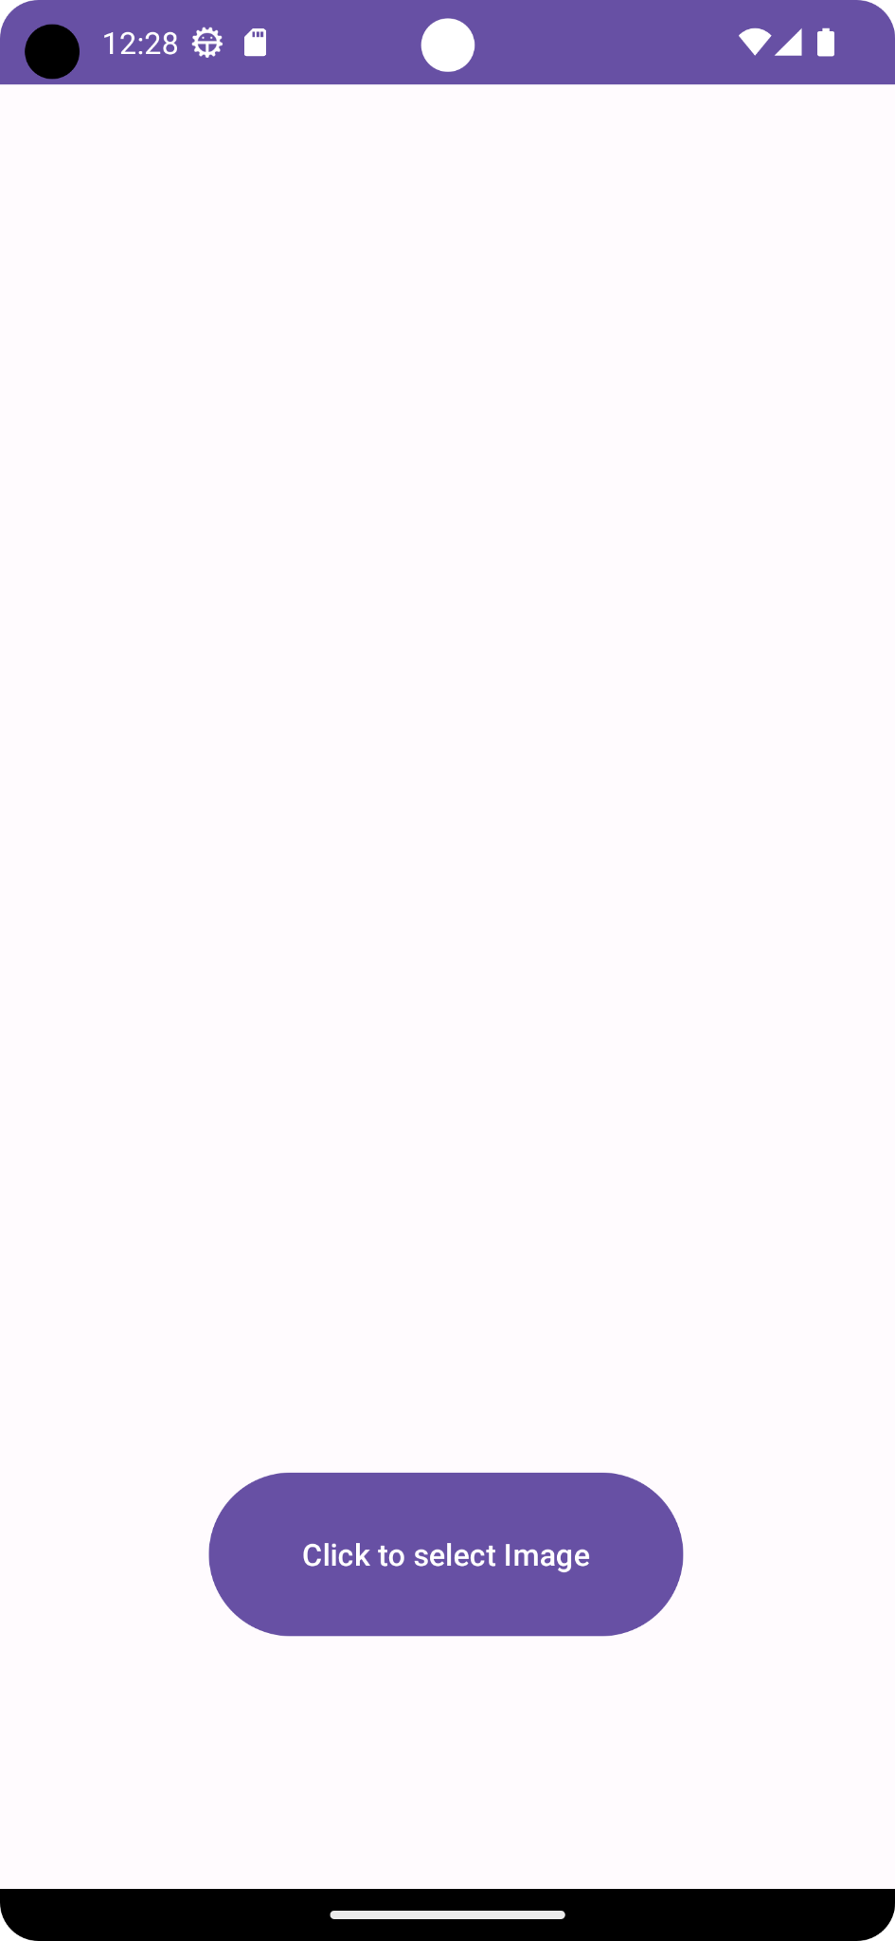
End Result
Current UI
Before selecting the image
On Start
Result after Calibration Process

Slide 12
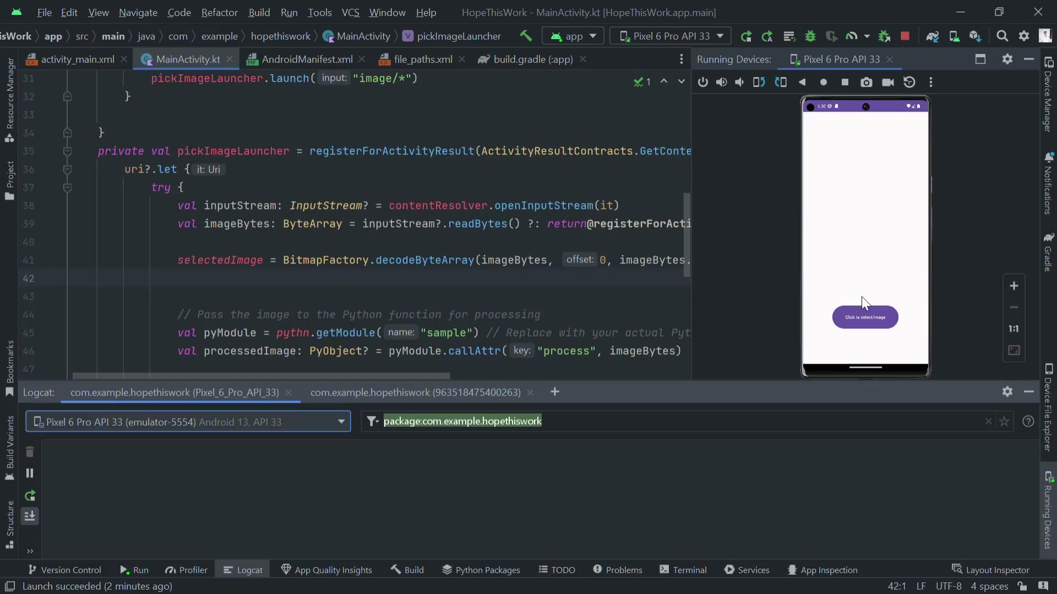
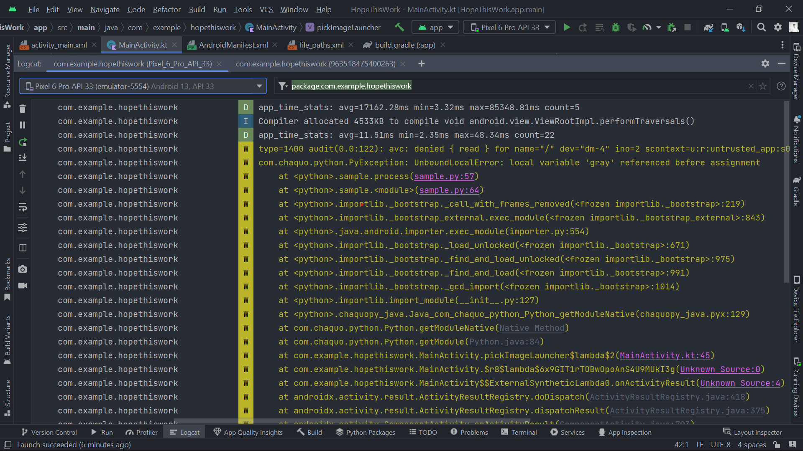
Current state of Project
Video of working App
Log file

Slide 13
Future Plan
Testing
Integration with QGIS and Computer Vision
Cross platform working
Final Deployment on Play Store

Slide 14
Qgis Installation And Set-Up
QGIS is a free and open-source geographic information system (GIS) software that can be used for a variety of tasks, including camera calibration. Camera calibration is the process of determining the geometric and radiometric properties of a camera. This information is used to correct for distortions in the images that the camera captures.
QGIS can be used for camera calibration in a number of ways. One way is to use the built-in camera calibration tools. These tools can be used to create a calibration model from a set of images that have been taken of a known object. Once the calibration model has been created, it can be used to correct for distortions in other images that are taken with the same camera.
QGIS is a powerful tool that can be used for a variety of tasks, including camera calibration. The built-in tools and third-party plugins make it easy to create a calibration model and correct for distortions in images.

Slide 15
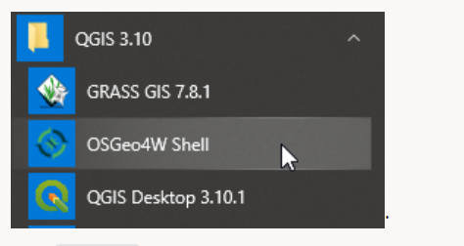
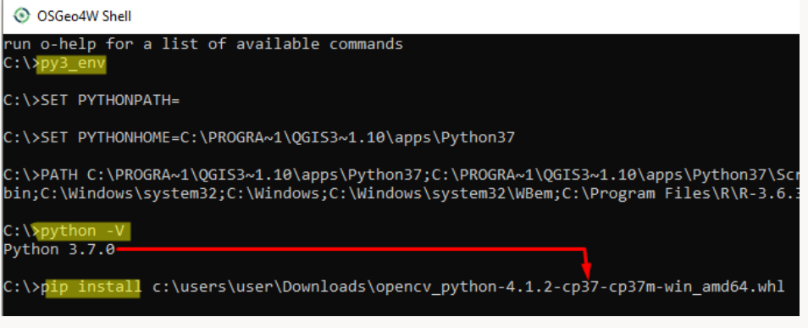
Python Set-Up

Slide 16
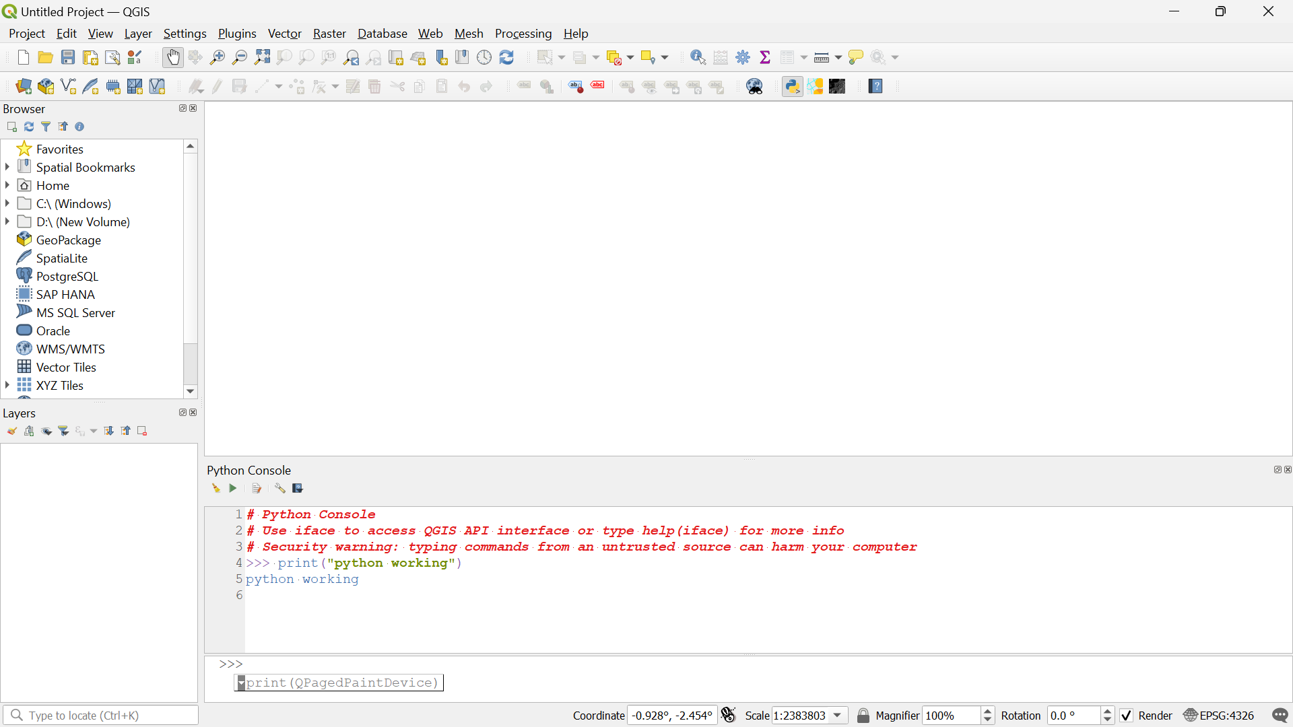
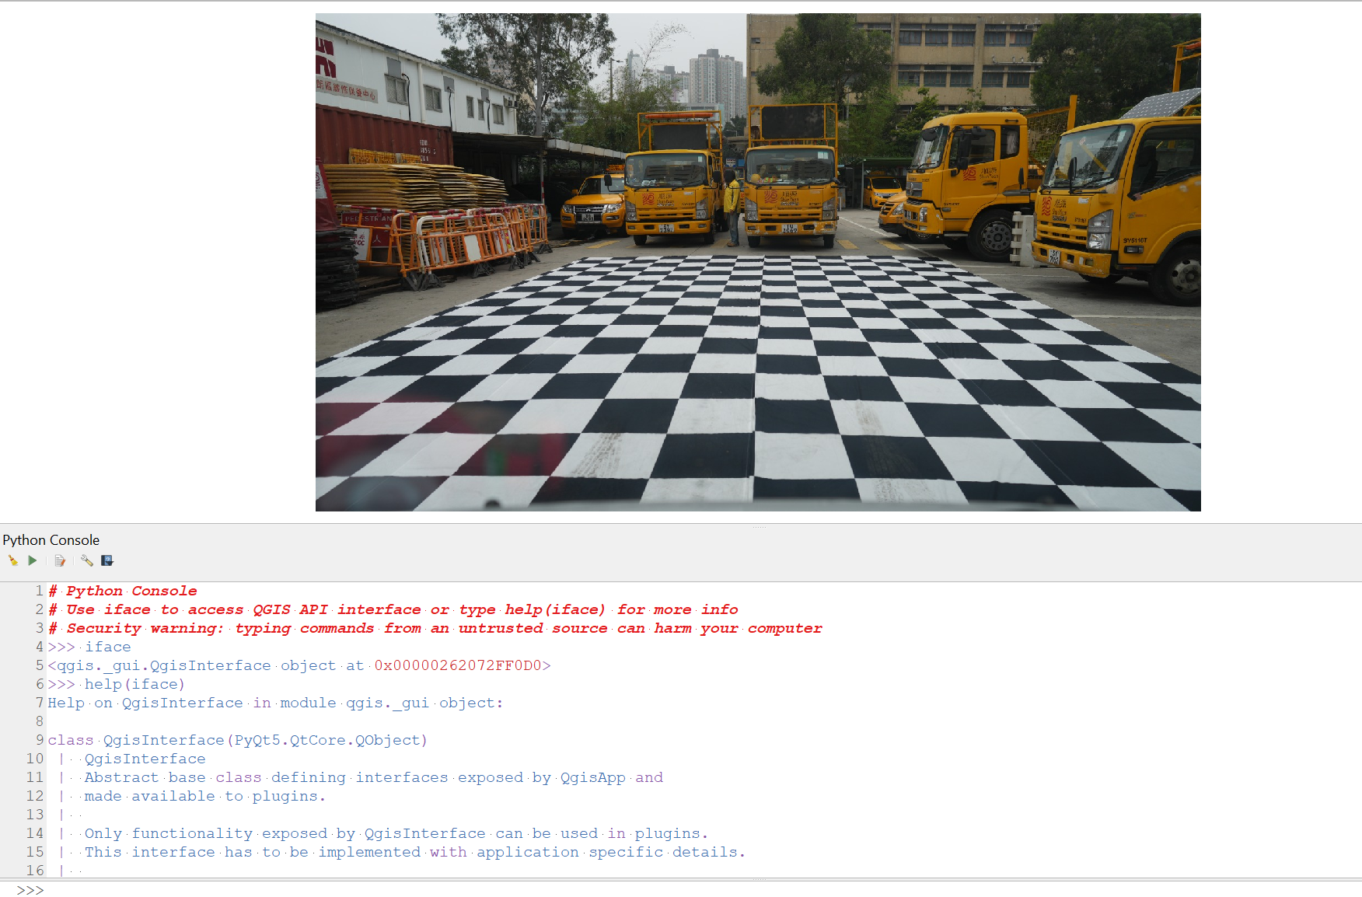
QGIS

